Slide 1
Network iii project
By : ali hamed, hassan Nasser eldeen

Slide 2
layout:
Sites:
Main branch Beirut
Secondary branch (Saida)
Third branch (Bagdad-Iraq)
Departments:
Beirut : Management, Servers, IT, Employees and Students.
Iraq/Saida: IT, Employee and Student.
Saida: Servers.

Slide 3
Infrastructure:
Beirut to Saida: Leased line.
Beirut to Iraq: Internet connection through ISP, with VPN, and Nat.

Slide 4
Internal layout:
Beirut:
Network ID 192.168.1.0/24, submitted at /27 for each Vlan.
Vlans: 10, 20, 30, 40 and 100.
Servers: DNS, Mail, Web, DHCP.
Saida:
Network ID 192.168.2.0/24, submitted at /27 for each Vlan.
Vlans: 20, 30, 40 and 100.
Servers: TFTP.
Iraq:
Network ID 192.168.3.0/24, submitted at /27 for each Vlan.
Vlans: 20, 30, 40.

Slide 5
VLANS:
10: Management X.X.X.0/27
20: IT X.X.X.32/27
30: Employee X.X.X.64/27
40: Student X.X.X.96/27
100: Servers X.X.X.128/27

Slide 6
DHCP:
Beirut/Saida:
DHCP Server present in the Beirut branch.
Iraq:
Router is configured as DHCP.

Slide 7
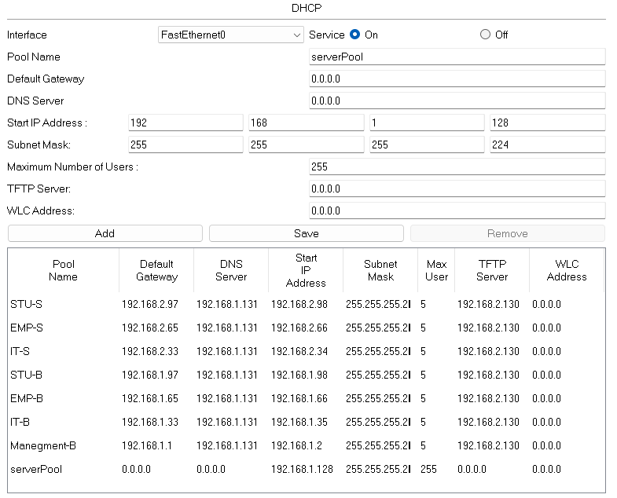
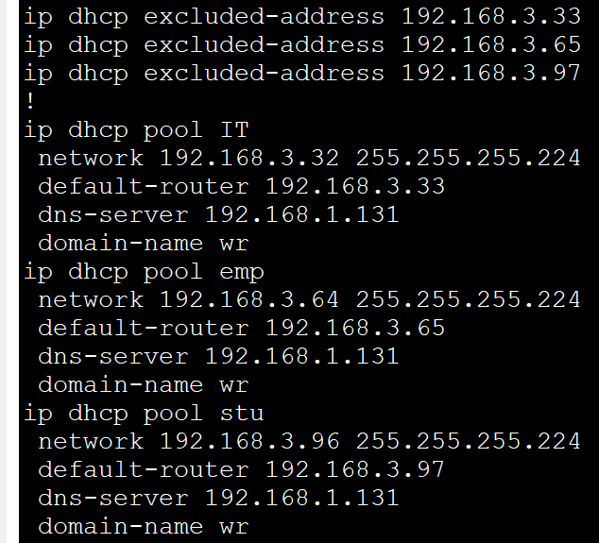
DHCP Configuration:
Beirut: Iraq:

Slide 8
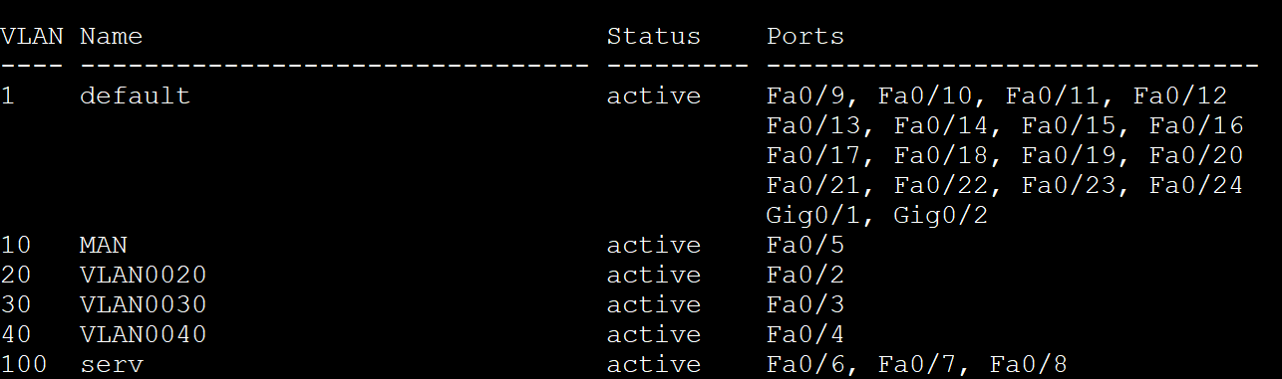
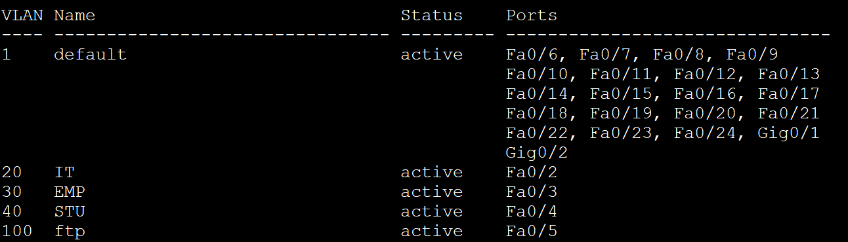
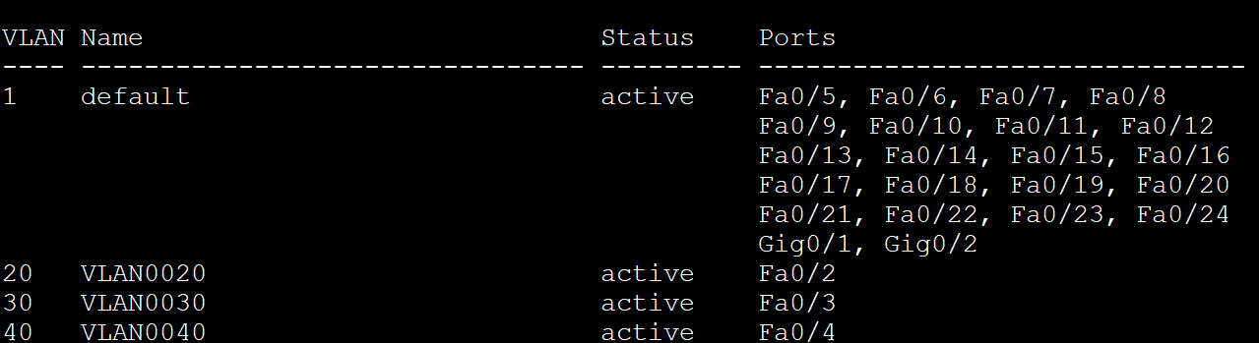
VLANS:
Beirut:
Saida:
Iraq:

Slide 9
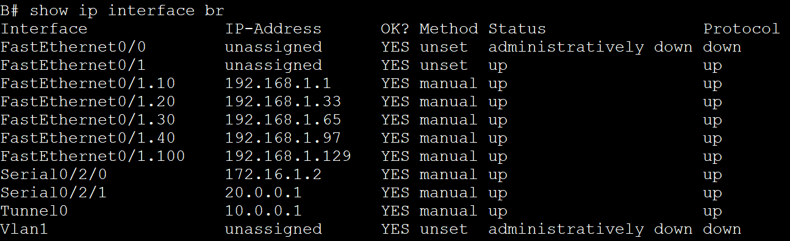
Port security:
Router on a stick(Beirut):

Slide 10
Routing:
OSPF:
Static:
PPP:

Slide 11
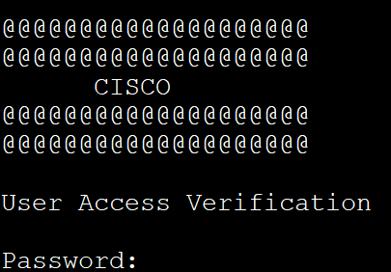
SSH:
Banner/Password:

Slide 12
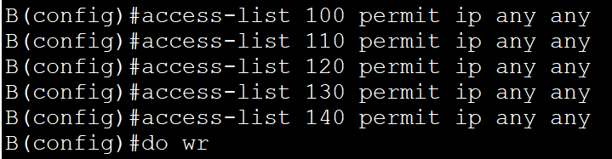


Nat/ACL:

Slide 13
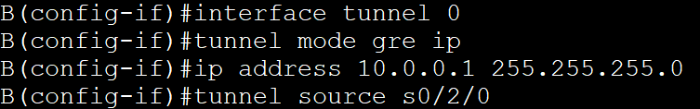
VPN:

